Slide 1
Information Security Concerns in Ethiopia
Arvin Bahrami, John “Cody” Balsamo, Henry Post

Slide 2
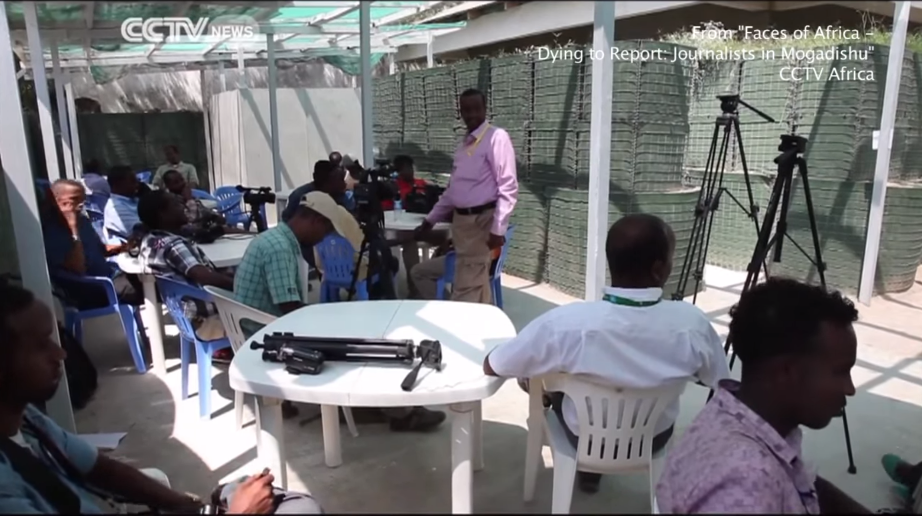
Preface
Reporting in Somalia has become exceedingly dangerous for reporters who would dare to go against the government’s will.
In spite of the dangers, privately owned media still exists thanks to information security technologies that can help reporters to stay undercover

Slide 3
Reasons for Security
“Checking where they can and can't go, who they can and can't speak to. Maneuvering around these barriers.”
Assassinations, Coups, targeted killings
Attacks on Omar Osman’s life
Text messages, calls , warnings and threats from terrorist groups.
If you perform actions the terrorist groups disagree with, they will directly let you know, tell you through subtext, or attack you
Large numbers of foreign journalists have been kidnapped.

Slide 4
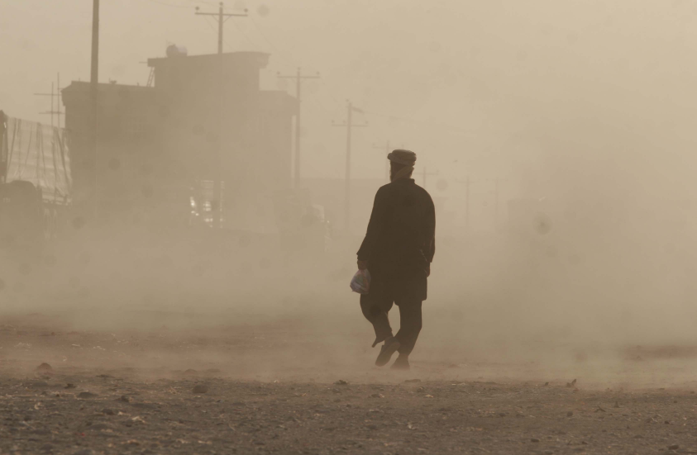
Database Environment
Cloud technology is not feasible due to high rates of internet outage, extremely low download and upload speeds and a state-owned monopoly on internet service
The land alters between dry seasons and rainy seasons, both dust storms and flooding can pose a danger to the database environment.

Slide 5
Database Security
Due to the poor state of internet connectivity in Somalia, reliance on pre-secured cloud services is not viable.
Databases need to be properly encrypted and secured to ensure the safety of its content.

Slide 6
Network Security Issues
Average internet speed is only 5kb/s
Internet is out 10-20% of the time
Only one ISP, government-owned
Only 0.4% of the population has internet access

Slide 7
Methods to check database architectural items such as the design of tables and interoperability
If the database is hosted on a website, checking for the presence of .php?id in the web address
Software such as SQLMap and Maltego can be used to tell if there are any major issues with the security of the database

Slide 8
Review strategic management plan and provide feedback
Journalists should be made aware of both the dangers they will face and the methods available to protect themselves
To make it as simple as possible, journalists should focus on simple and actionable goals such as learning to use encrypted email services, having an outfit planned ahead when covering a certain area etc.

Slide 9
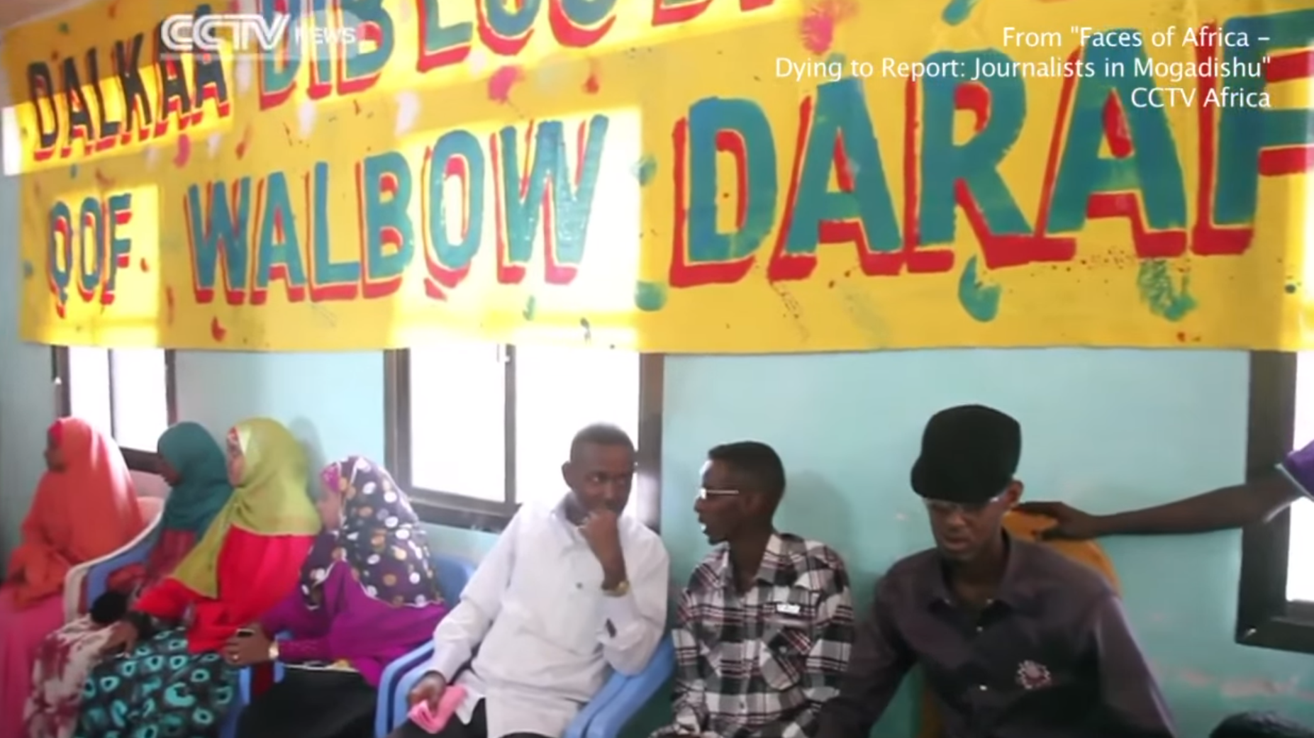
Other Issues
Will security measures be adopted across-the-board?
If they aren’t, does trusting people who DON’T follow security procedures introduce risks of working with or trusting that ‘insecure person’?
Are those security measures legal in the country they’re being used in?
ECT Act
RICA
If reports are anonymized, will the public trust them?

Slide 10
Other Issues cont.
Just how much does the government track?
Can we trust the hardware of laptops?
Can we trust inter-network comms? Intra-network comms?
Can we trust downloaded software to not be compromised?
What is or isn’t bugged?
How expensive will it be to implement our security procedures?
Can our current devices support some/all of our requirements?
What do we do if they can’t?

Slide 11
Actions that could be taken to prevent or fix problems
Reports will be anonymized
This solves the problem of authors being targeted
May introduce integrity problem, i.e. ‘how do we know a credible source reported on this?’
Perhaps reports themselves could be digitally signed by a reporter
Reporters should attempt to appear like normal people
If they don’t look like reporters, there’s less risk of them being discovered
Reporters should not affiliate themselves with any radio station/news group
Again, if you can’t tell they’re reporters, less danger.

Slide 12
Actions cont.
Reporters and news stations should use asymmetric encryption
This will replace trusting people by virtue of knowing them
Anonymizes the person
Anonymizes the news station’s employees and the news station itself
Downside: You can only trust them as much as you trust the security of the private key/who generated it, and their habits regarding keeping their private key safe.
Reporters should set up contingency plans
What do I do if my laptop/cellphone gets seized? Are they encrypted?

